Slide 1
Crime Data Analysis
IE 6400
Foundations of Data Analytics
By: Sushmitha Sudharsan, Harini Prasad Vasisht, Tanmayi Shurpali

Slide 2
Introduction
Analyzing crime data plays a crucial role in ensuring citizen safety.
This project focuses on analyzing the LAPD Crime Dataset from 2020 to present.
The dataset consists of 97,000+ entries. We used the most relevant attributes to conduct our analysis.

Slide 3
Project Workflow Overview
1. Data Acquisition and Inspection
2. Data Cleaning
3. Exploratory Data Analysis (EDA)
4. Data Visualization

Slide 4

Data Acquisition and Inspection
We loaded the crime data was loaded using Pandas in Jupyter Notebook.
The the .head() and .info() functions were used to inspect the dataset to understand the structure of the dataset.

Slide 5
Data Cleaning
Vict_Sex had 32,184 NULL values, so only Male and Female values were retained.
Vict_Age contained invalid negative values, which were corrected.
Columns with many NULL values and irrelevant data were dropped.

Slide 6
Exploratory Data Analysis (EDA)
EDA identified patterns, trends, and anomalies in the dataset.
Visualization methods were used to enhance understanding of data relationships.

Slide 7
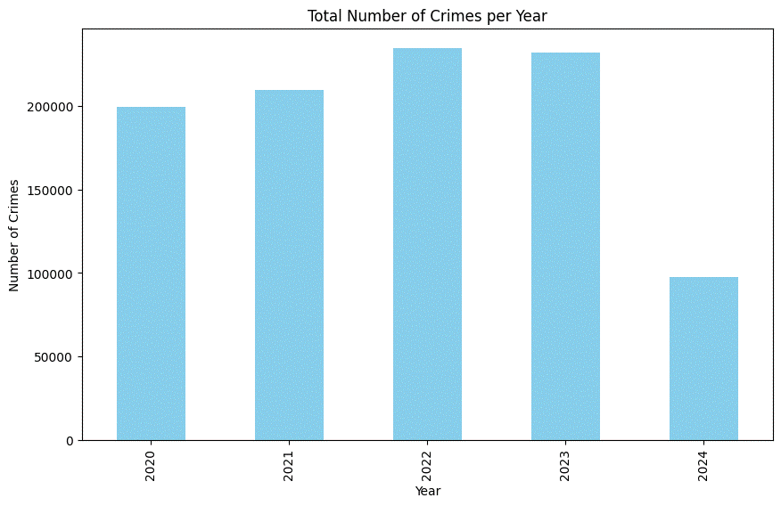
Total Crimes Over Years
The total number of crimes increased from 2020 to 2023.
2022 saw the highest number of crimes, followed closely by 2023.
There was a slight decrease in crimes in 2023 compared to 2022.
In 2024, the total number of crimes significantly dropped compared to the previous years.
This visualization shows the total number of crimes reported from 2020 to 2024.
The graph indicates an upward trend from 2020 to 2023.
There is a notable decline in 2024, suggesting potential impacts from law enforcement changes or policies.

Slide 8
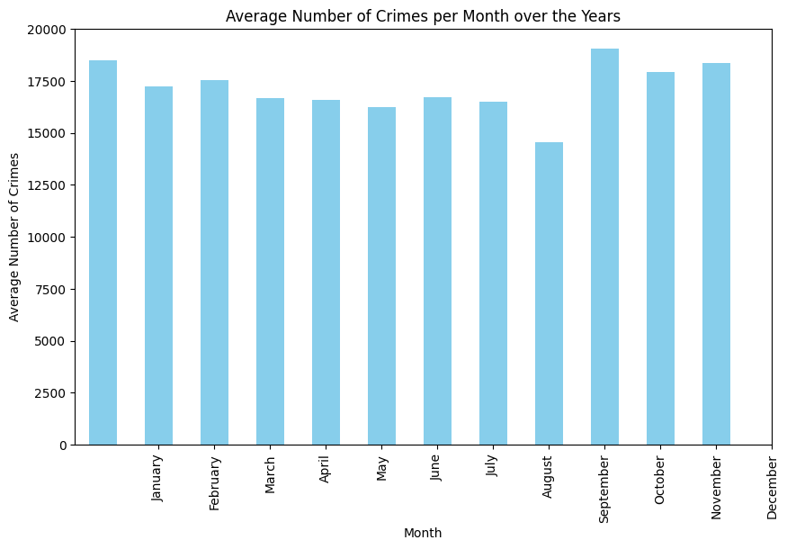
Average Crimes Per Month
Crime rates remain stable throughout most of the year.
August shows a noticeable drop in crime activity.
September and October have the highest average crime rates.
January, February, and November also show elevated crime rates, though slightly lower than September.

Slide 9
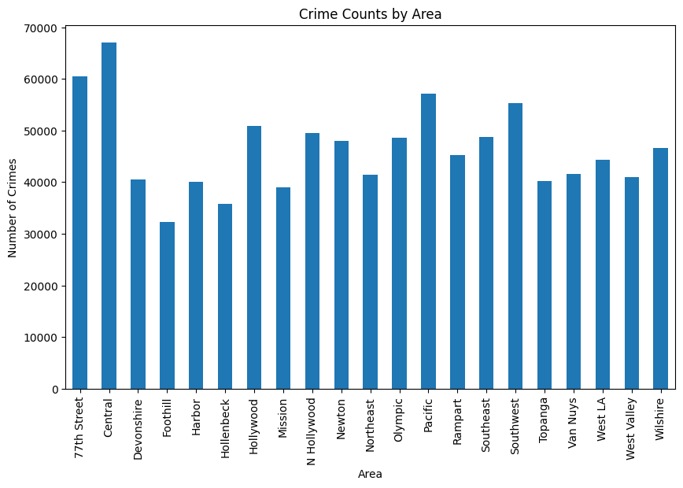
Crime Counts by Area
77th Street & Central: Highest crime rates, mostly vehicle theft.
Van Nuys: High burglary due to wealthier neighborhoods.
Devonshire & Harbor: Mainly vehicle theft, similar to urban areas.
West LA, Wilshire, Topanga: Moderate crime, with burglary from vehicles common in West LA.
Key Insights:
Vehicle theft is a major issue across many areas.
Burglary targets wealthier regions like Van Nuys.
Battery/Simple assault is less frequent.
This summary highlights crime hotspots and trends by area.

Slide 10
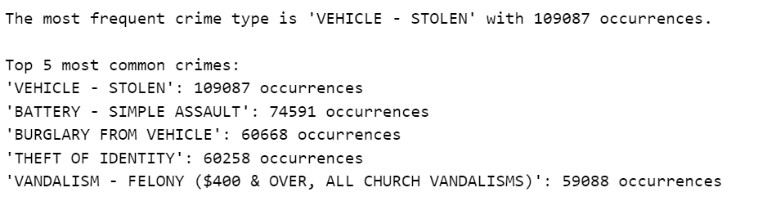
Top Crime Types
Vehicle Theft: Most prevalent crime with 189,887 occurrences, highlighting a major issue.
Violent & Property Crimes: Second most common with 74,591 occurrences, indicating frequent physical altercations.
Burglary from Vehicle and Vandalism Felony also rank in the top 5, pointing to property-related crimes.
Identity Theft: Fourth most common crime with 68,258 occurrences.
Other Key Findings:
Area-Specific Crime Patterns:
Central: Burglary from vehicles is the most common.
West LA: Burglary into homes or businesses is prevalent.
Consistent Trends: Vehicle theft remains a top crime across most areas.

Slide 11
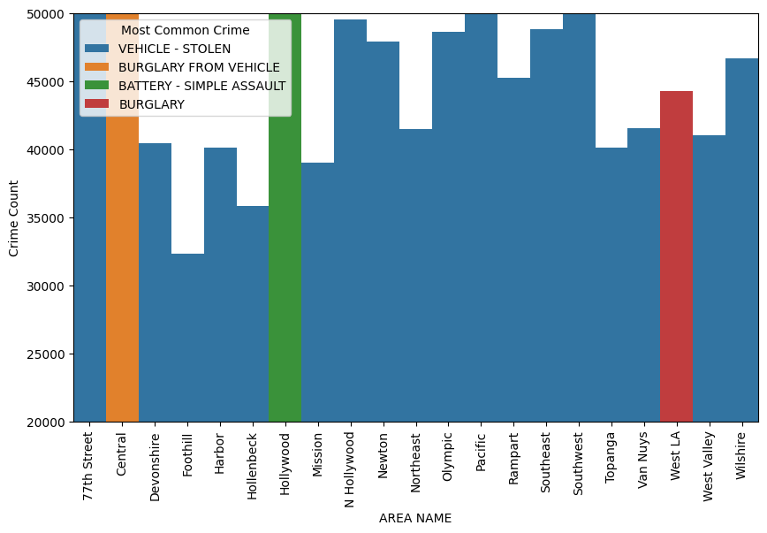
Most Common Crimes in Los Angeles
Vehicle Theft Dominance: The histogram shows consistently tall bars for "Vehicle Stolen" across most areas, making it the most frequent crime in the city.
Area-Specific Patterns: Different areas show varying crime rates (e.g., assault, burglary), indicating that crime types differ by location.
Crime Hotspots: Areas like Newton and 77th Street have noticeably higher bars, highlighting them as crime hotspots.

Slide 12
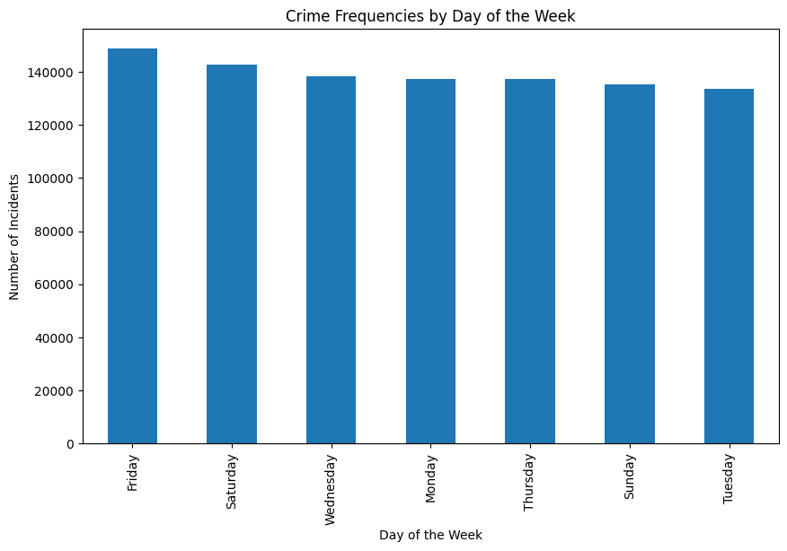
Crime by Day of the Week
Friday & Saturday: Highest crime rates, likely due to increased social activities, nightlife, and alcohol consumption.
Monday, Wednesday, & Thursday: Consistent crime levels throughout the week, reflecting routine activities and workplace-related incidents.
Sunday & Tuesday: Lowest crime rates, with Sunday seeing fewer crimes, likely due to family or religious activities.
Key Insights:
Friday & Saturday: Increased law enforcement presence needed around nightlife areas to prevent crime.
Weekday Consistency: Crime occurs regularly, even on weekdays, requiring steady resource allocation.
Sunday: A quieter day, allowing for resource reallocation to busier days.

Slide 13
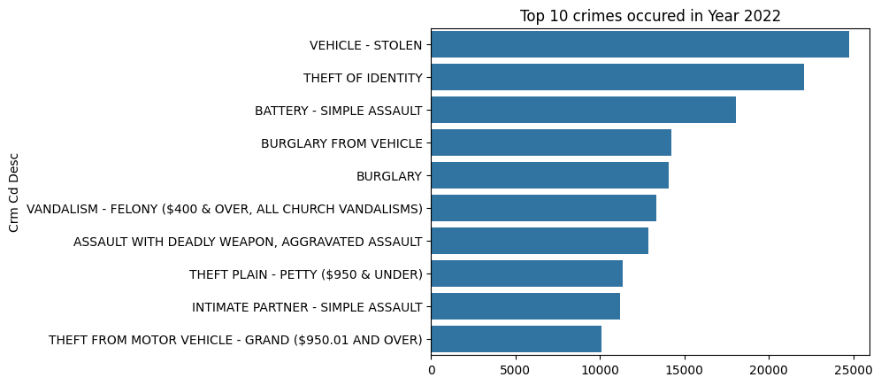
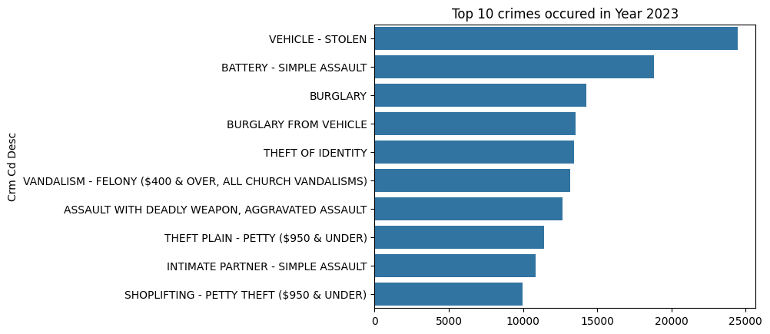
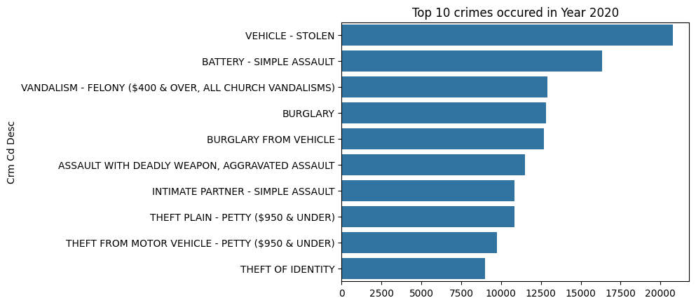
Crime Trends Summary (2020-2023)
Vehicle Theft:
Consistently the most reported crime across all three years.
Battery - Simple Assault:
Remained a top crime, indicating ongoing issues with interpersonal violence.
Burglary:
Both general burglary and burglary from vehicles remained prevalent.
Theft of Identity:
Fluctuated, peaking in 2022 before dropping in 2023.

Slide 14
Conclusion
Vehicle theft remains the most significant problem in the area.
Area-specific crime patterns were identified (e.g., burglary in West LA).
A notable decline in crime in 2024 suggests potential policy changes or interventions.

